Slide 1
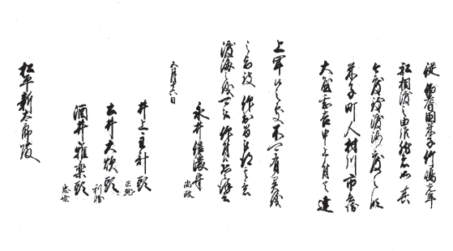
Permission for passage [Tottori Prefectural Museum]

